Slide 1
CV in English
Resume = same, but longer (including your education etc)

Slide 2
The contents of your cv

Slide 3
Who are you?
Name
Age
Contact information
Save the personal stuff for your conversation

Slide 4
What are you good at?
Skills: multitasker, flexible, social
Languages: mention the level:
Dutch: native
German: intermediate
English: near-native
Experience: try and keep it relevant.
I’m pretty darn good with a whistle

Slide 5
Why should they hire you?
SHOW them (experience, enthousiasm, skills)
Why do you want to work there? Why them and not their competition?
In which areas can you learn/grow?

Slide 6
The contents of your cv
Who are you? (show your best “you”! Don’t mention you hate cats or like to get drunk at parties)
What are you good at? (YOUR SKILLS: tell them relevant things: if you want to work at a pet store, they don’t need to know you are good at knitting)
Why should they hire you? (because you are awesome at what they need you to do. Also tell them how they can know you are awesome at that job: I have worked with dogs for 4 years now)

Slide 7
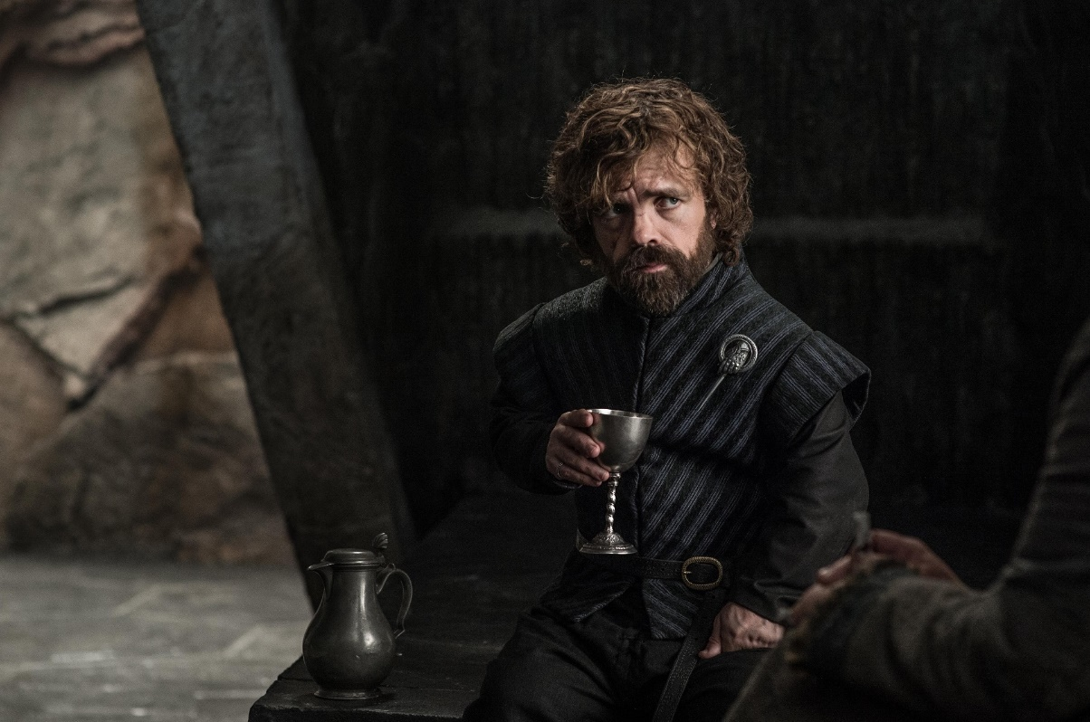
PS. all this as short as possible, not boring, attractive and a little bit dangerous…
WHO are you
WHAT are you good at
WHY should they hire you
…like that guy on Game of Thrones

Slide 8
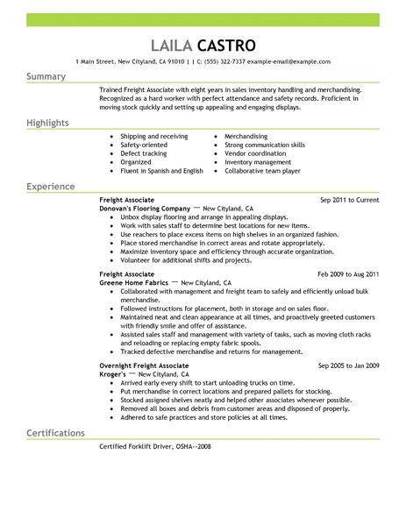
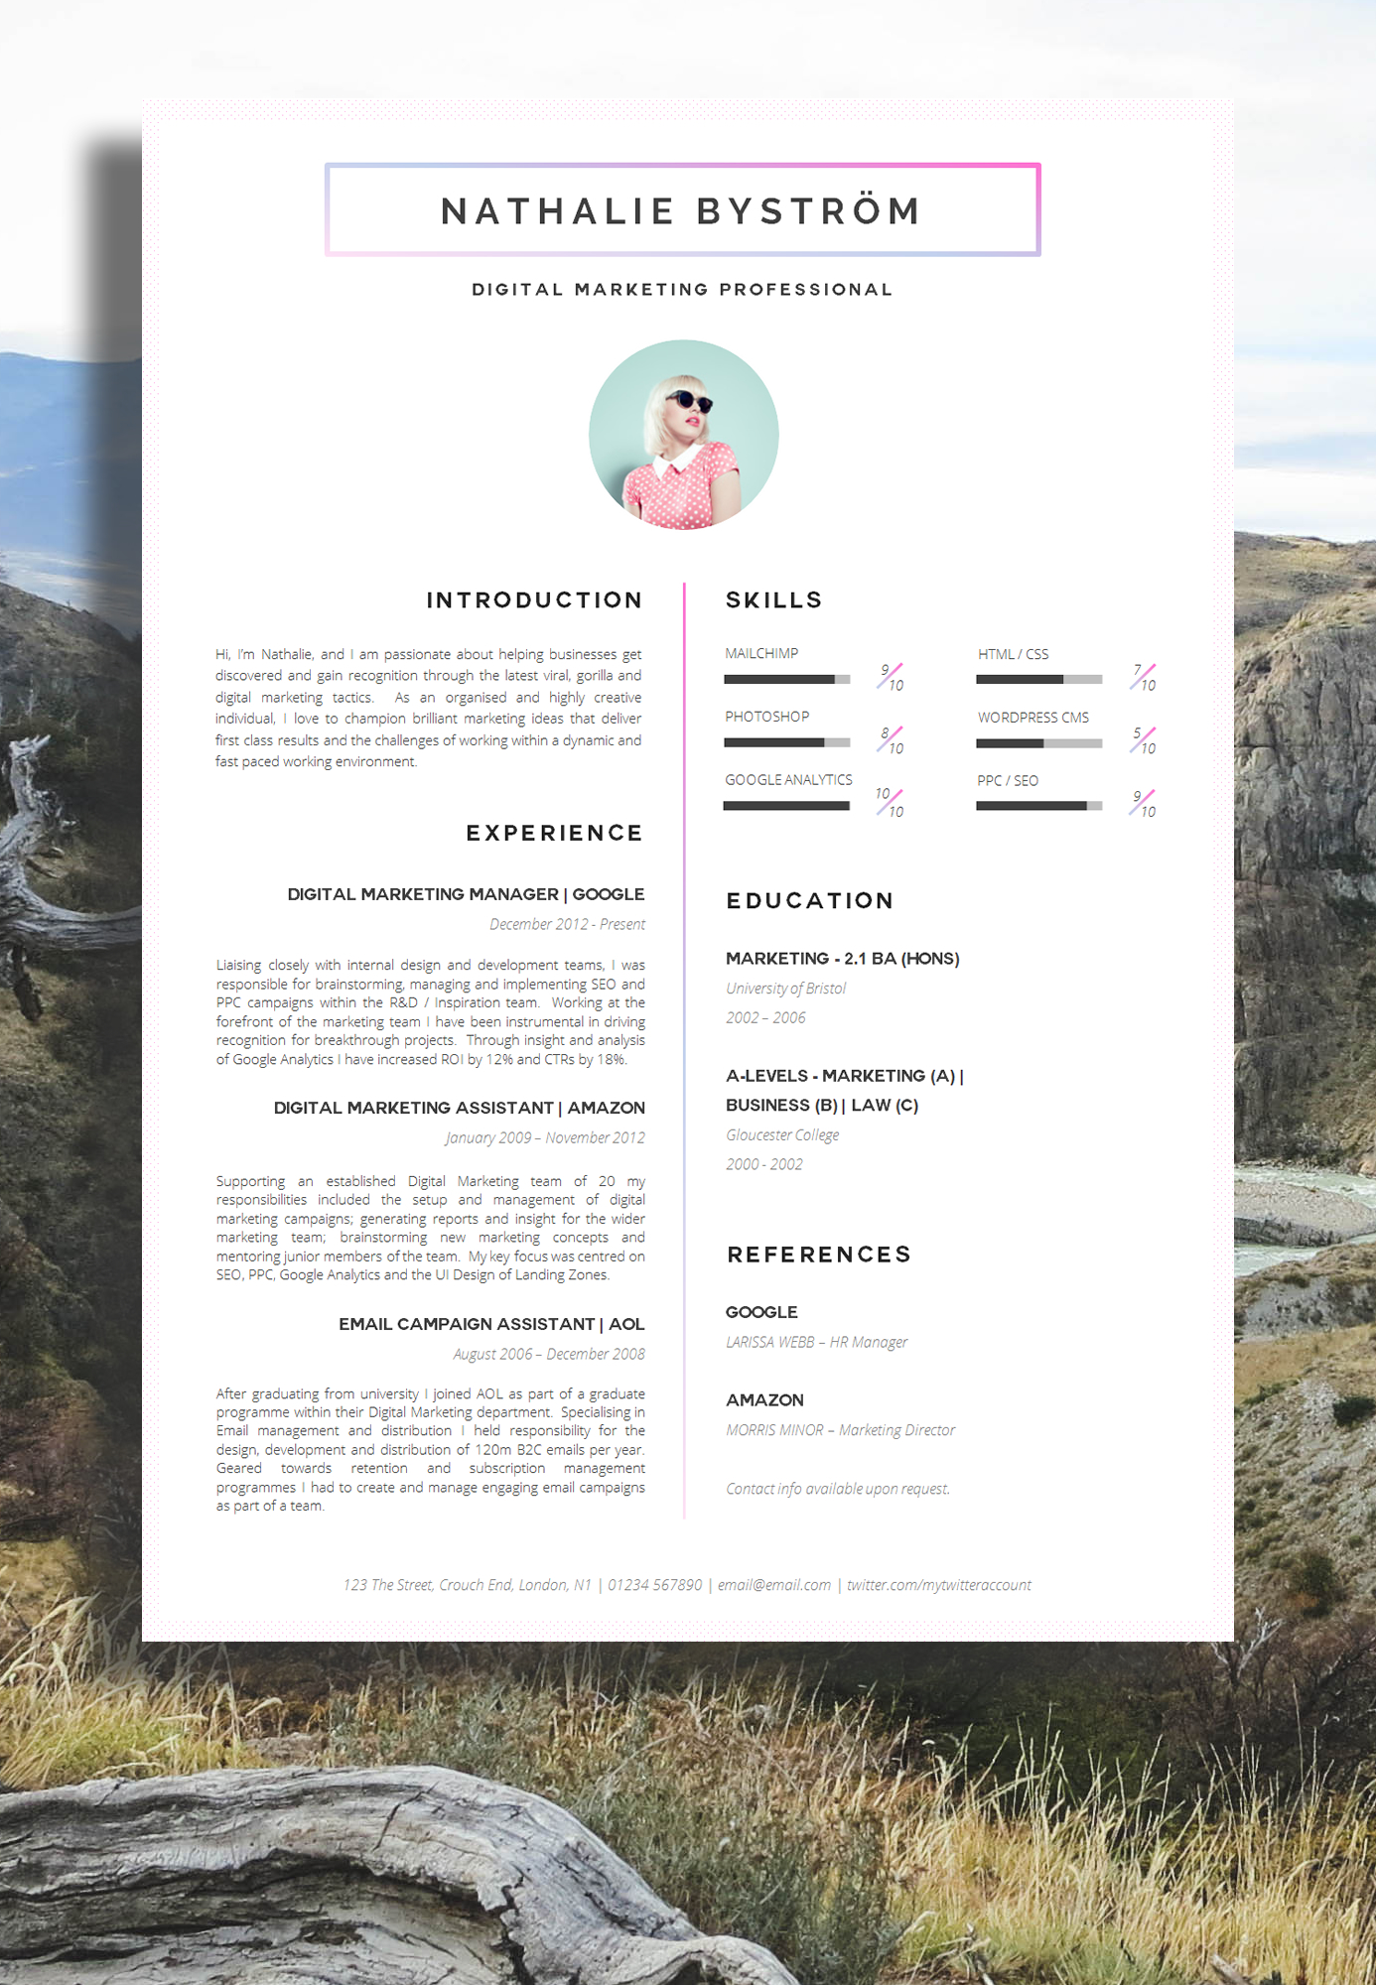
Examples:
Which one goes on your ‘accept’ pile?

Slide 9
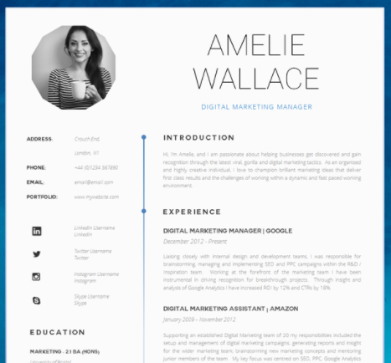
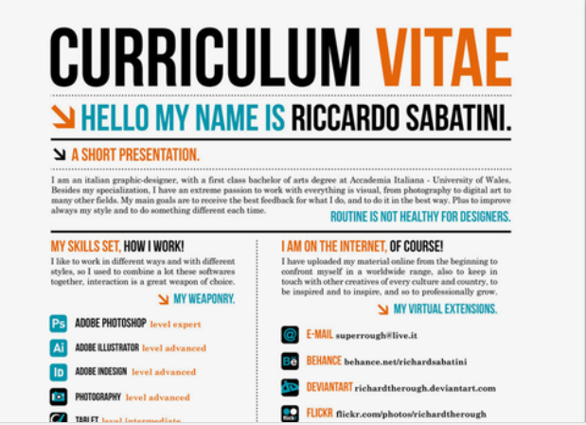
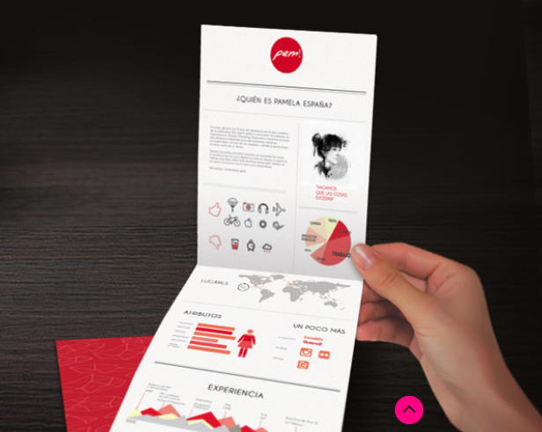

Slide 10
The STYLE of your CV
you have to stand out

Slide 11
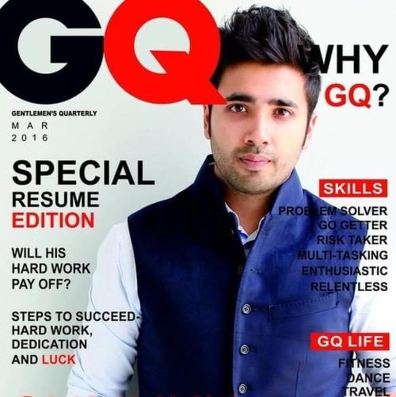
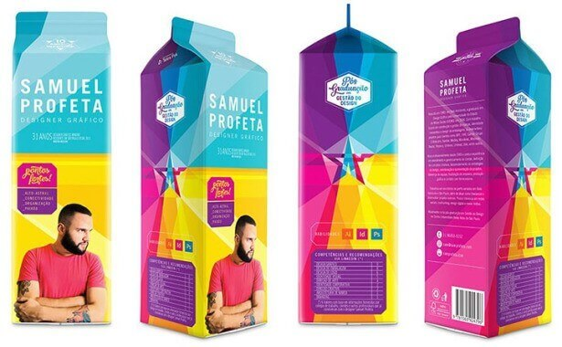

Slide 14
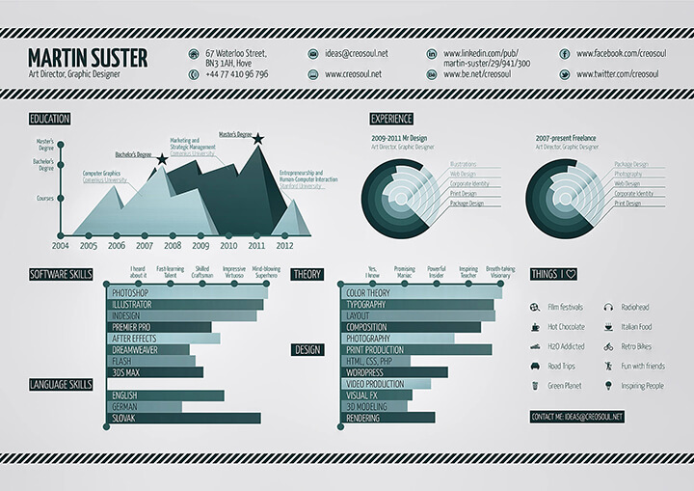

Slide 15
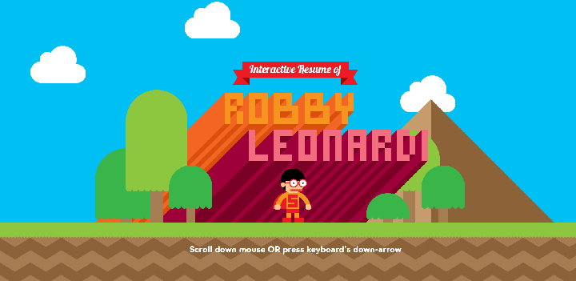
Click the picture
http://vizualize.me/jeroen1?r=jeroen1

Slide 16
Video CV
https://youtu.be/KdxvRrhLiis

Slide 17
summary
Who are you?
What are you good at?
Why should they hire you?
Stand out

Slide 18
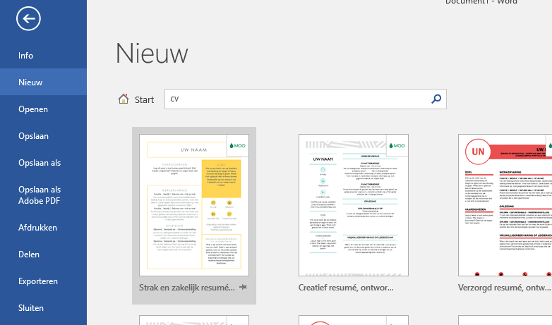
CV format in Word

Slide 19
Related assignment!
Look at the vacancy below. Create a CV that fits the vacancy!
We’re hiring!
The position: Teamleader at our tech department
We are looking for:
-a teamplayer with strong ICT skills
-a strong personality
-some with the drive to get things done!
Send your CV with cover letter to: Info@Awesomecompany.com

